Slide 1



Movie
Recommendation

Slide 2

Meet Our Team
AHMAD LAMAAT
AHMAD ALI BARLAS
ALI NAVEED BUTT

Slide 3
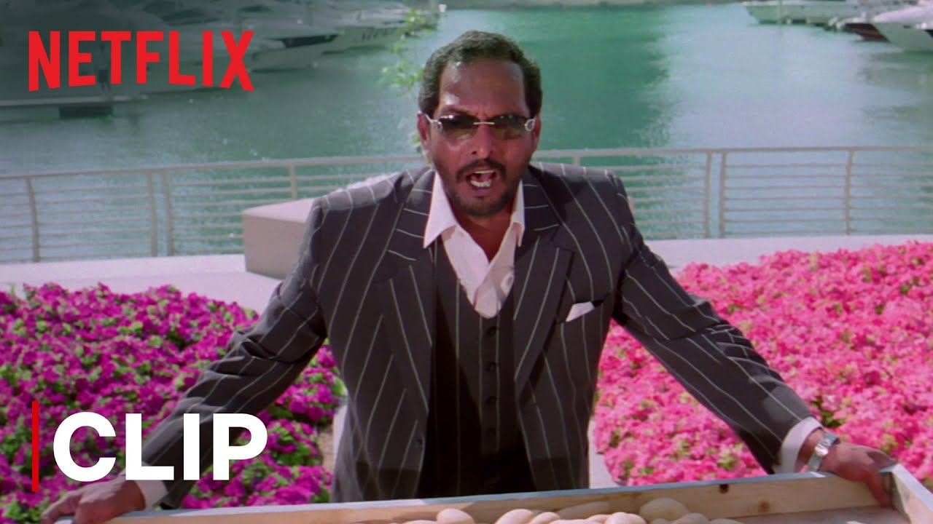
Introduction
This project builds a content-based recommendation system for Netflix-like data, suggesting movies or TV shows based on user preferences. It cleans and preprocesses the dataset, visualizes key insights, and uses natural language processing to process text data like descriptions and genres. Categorical features are numerically encoded, and feature vectors are created from attributes like type, director, and cast. The system uses cosine similarity to rank and recommend similar titles, offering personalized content suggestions by combining data science, NLP, and machine learning techniques.

Slide 4


Our Project
01
Develops a content-based recommendation system to suggest movies or TV shows based on user preferences.
02
Utilizes data preprocessing, visualization, and NLP techniques for feature extraction and analysis.
03
Employs cosine similarity to rank and recommend titles, creating personalized content suggestions.

Slide 5

Data cleaning
This part of the code is responsible for cleaning and preparing the dataset:
01
Replaces 'NaN' values with 'NA'.
02
Removes duplicate entries of movies or shows.
Drops unnecessary columns that are not required for building the recommendation engine.
03

Slide 6
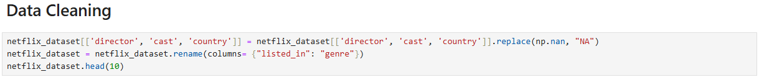
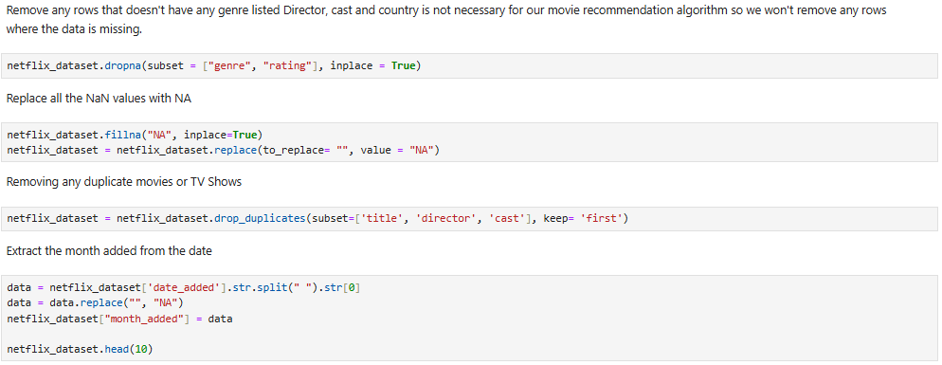

Slide 7
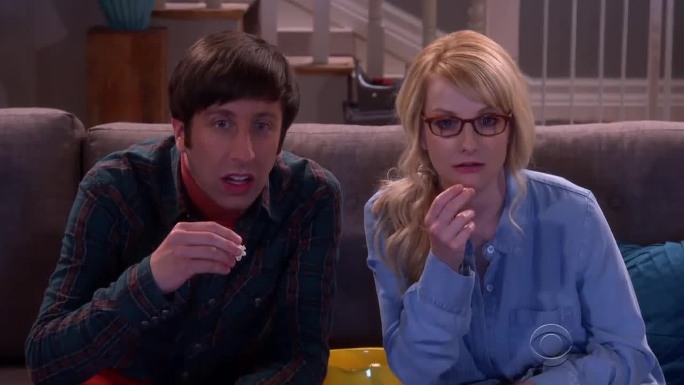
Data visualization
01
Displays the ratio of movies to TV shows.
Visualizes the months when most movies are added.
Examines the distribution of movies/TV shows across 10 countries.
Analyzes content based on ratings.
Visualizes the distribution of content by genre.
Highlights the top 5 directors by content quantity.
02
03
04
05
06

Slide 8
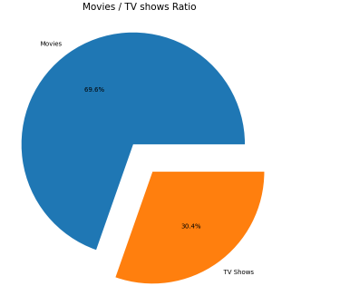

Slide 9
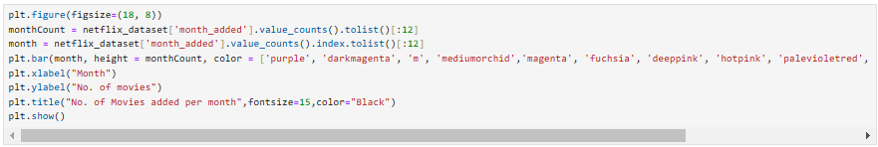
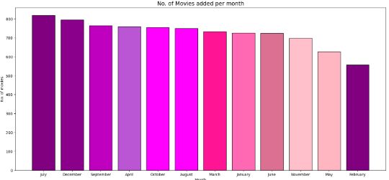

Slide 10

dataset encoding
01
Converts categorical data into numeric format, as machine learning models typically require numerical inputs.
Limitations of LabelEncoder:
01
Assigns integers arbitrarily, which may imply an unintended ordinal relationship.
02
For unordered data (e.g., movie ratings like PG, PG-13), this can cause inaccuracies in certain models. Alternatives like one-hot encoding might be preferred.

Slide 11
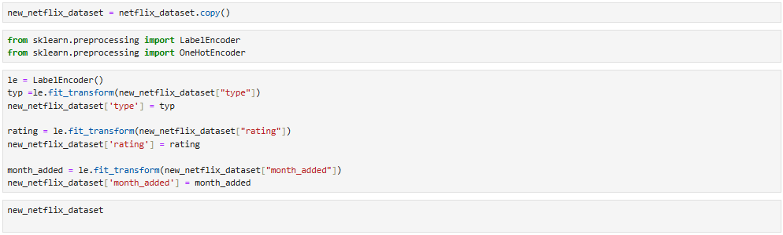

Slide 12


Lemmatization reduces words to their root forms using WordNetLemmatizer.
Tokenization breaks text into clean word tokens using a regex tokenizer.
Feature extraction converts text into numerical features using CountVectorizer (bag-of-words) while ignoring common English stop words.
01
02
03
Text Preprocessing with nltk

Slide 13
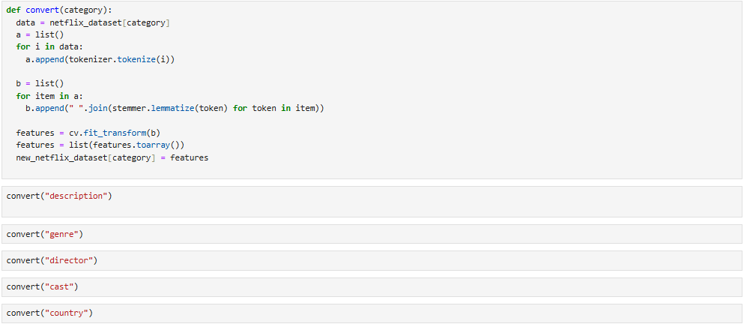

Slide 14
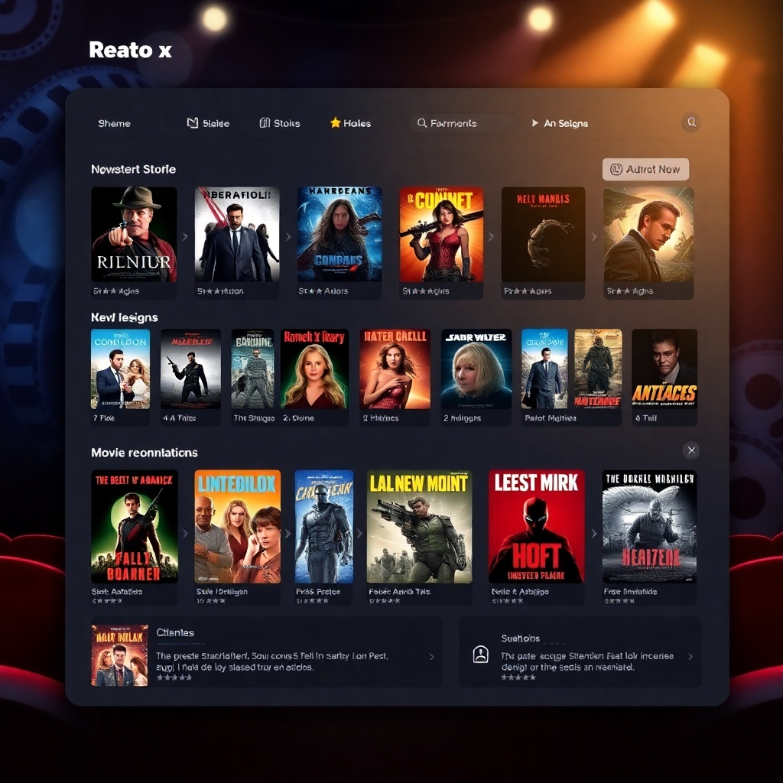
preprocessing of new_netflix_dataset
01
Correlation Analysis examines relationships between features like genre and description.
Data Preparation drops irrelevant columns, sets the title as the index, and creates feature vectors by scaling and combining attributes (e.g., type, cast, country).
02
Vectorization converts rows into numerical vectors stored in vec_df for tasks like clustering or recommendation systems.
03
Key Purpose:
Makes Netflix data machine-readable for advanced modeling and analysis.

Slide 15
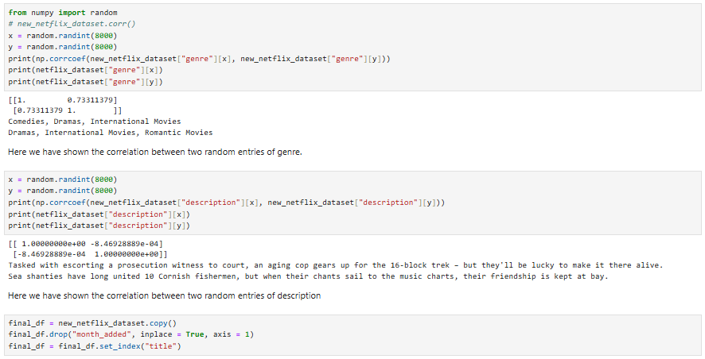

Slide 16

implementation
top_10(name) calculates cosine similarity between the given title and all others to find the top 10 most similar titles.
recommend(name) retrieves detailed information about these similar titles from the dataset.
01
02
Summary
01
Input: A title (e.g., "Zombieland").
Process: Identifies and ranks similar titles based on feature similarity.
Output: A DataFrame with details of the top 10 recommendations.
02
02

Slide 17
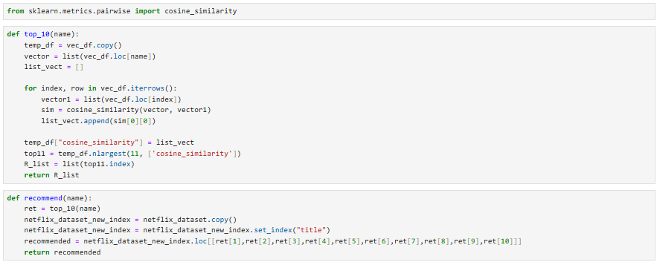

Slide 18
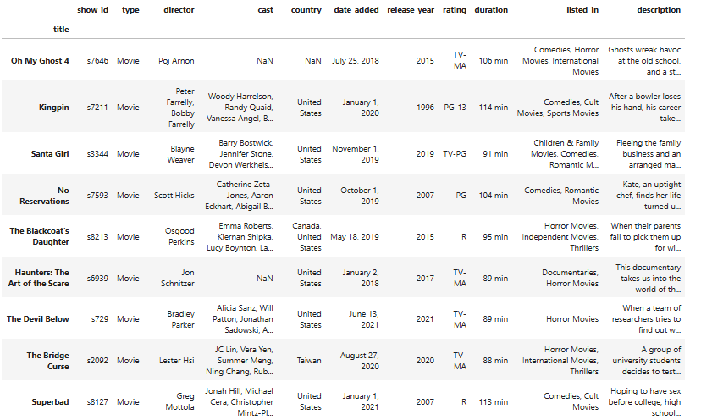

Slide 19

Thank You

